Slide 1
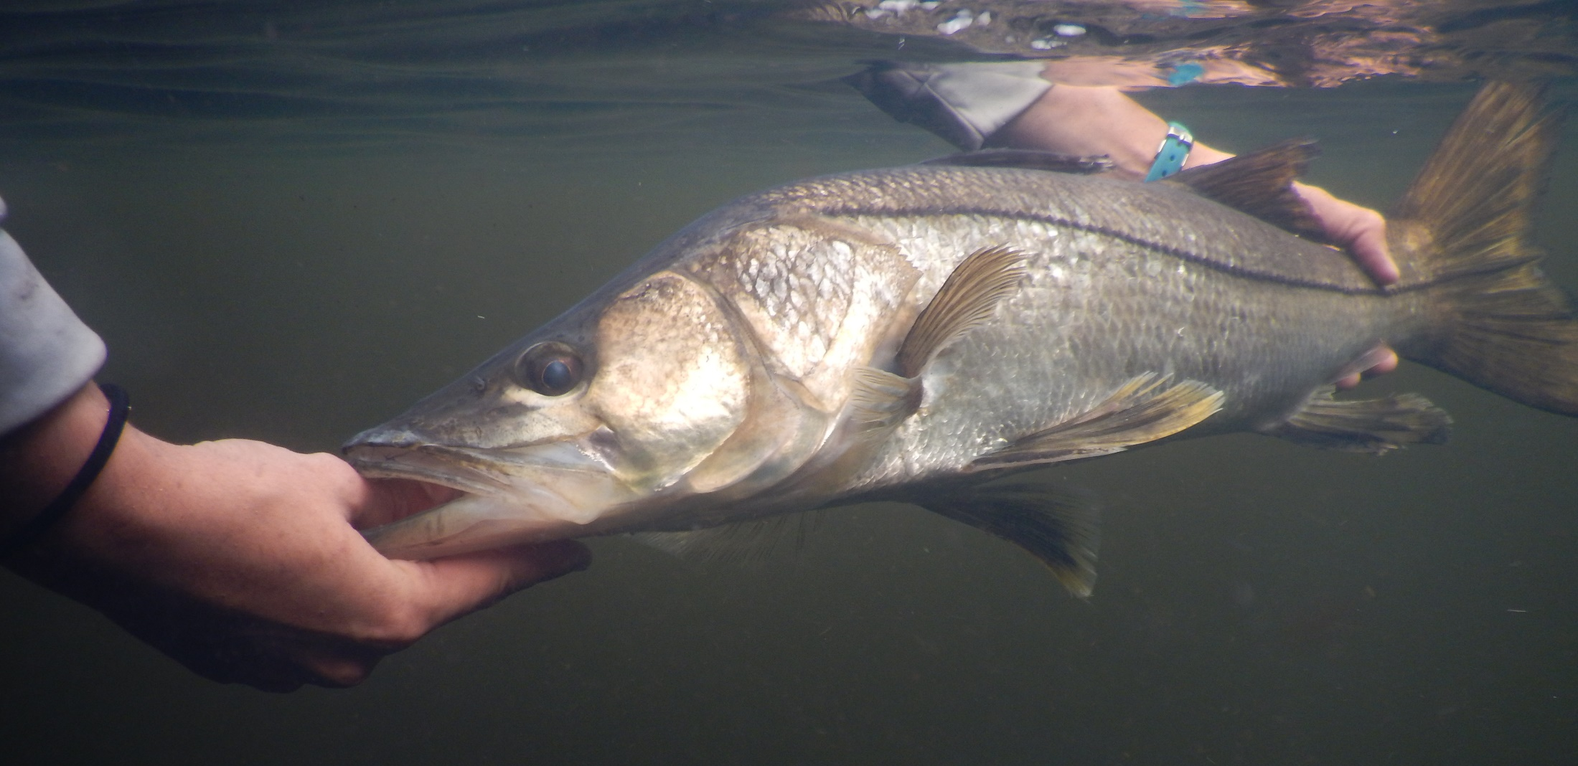
Potential Titles:
-Environmental forcing drives similarity in the space use in a riverine consumer
-Hydrological conditions drive switch from similar to dissimilar space use in a riverine consumer
-Seasonal hydrology drives individual variation in space use in a riverine consumer
Rehage, Santos, Massie, Viadero, & Stevens
Proceedings Royal
Soc London (IF=4.3)
JAE 4.4
Movement Ecol 3.7

Slide 2
Introduction: rationale
1) A primary way in which animals respond to env heterogeneity is with their movements
2) New tracking techniques are greatly improving our understanding of exactly org track this env heterogeneity
3) A key insight of tracking data is the high levels of ind variation –that can match or exceed interspecific variation
4) But at same time, env heterogeneity can act to synchronize movements
- A great example of this is how org track phenological variation in resources across space (resource waves) resulting in similarity in space use & synchronized mov patterns across the landscape

Slide 3
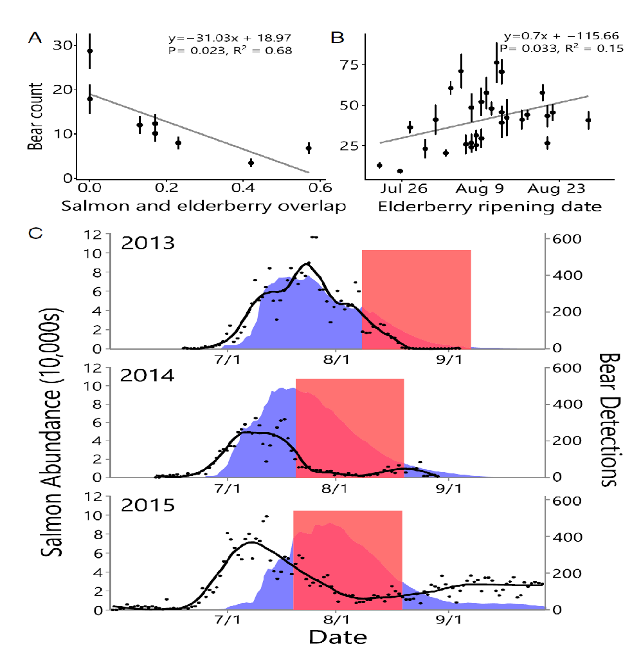
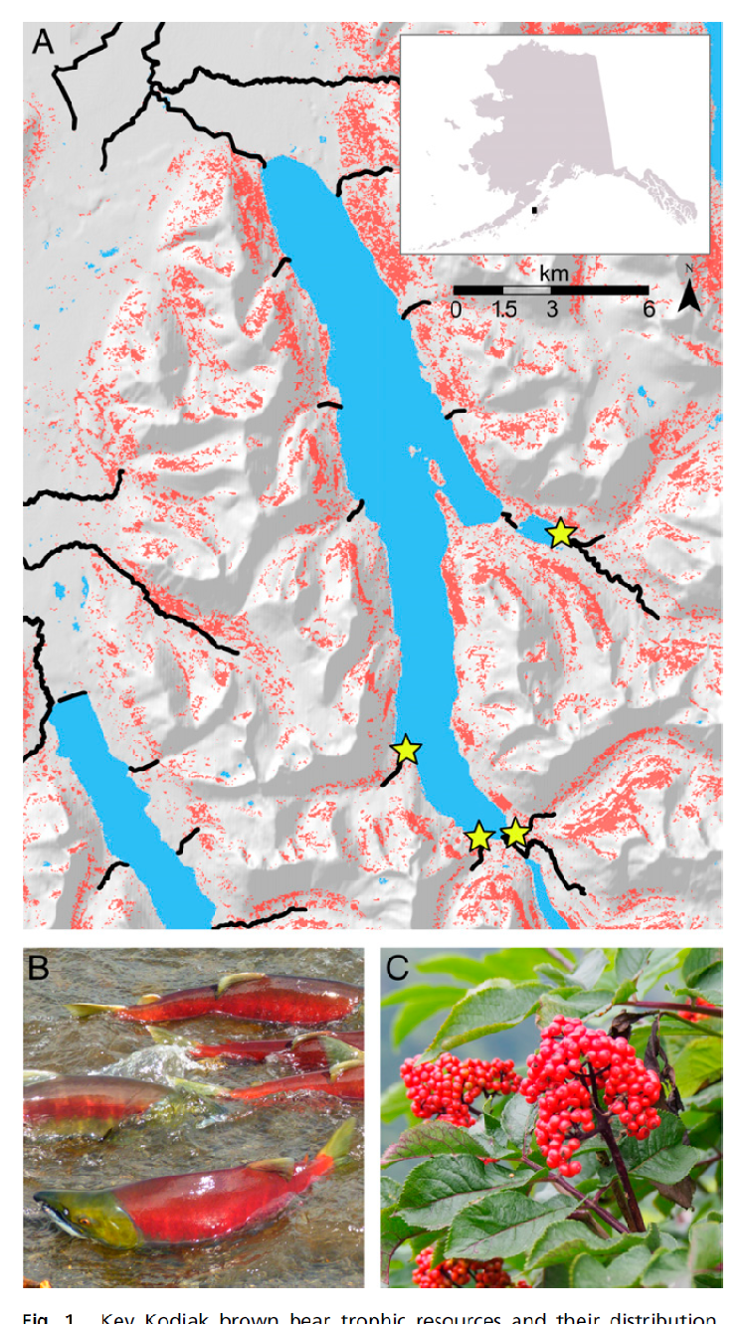
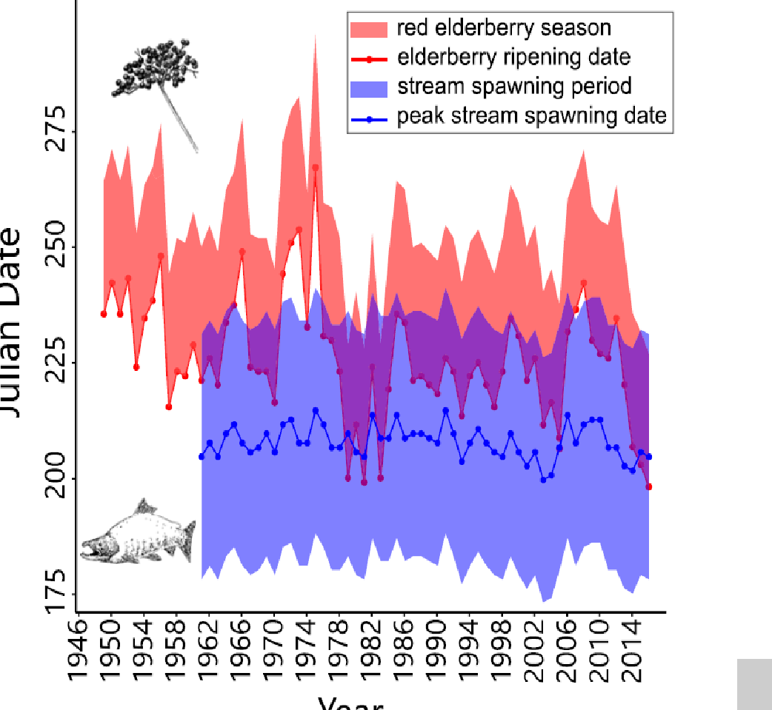
Daily bear detections in lakes
Sockeye salmon abundance
Red = elderberry availability
Bears track salmon in space, if berries & salmon don’t overlap
Climate change is causing resource overlap & bears choose berries & reschedules trophic interactions
Deacy, Armstrong et al 2017 PNAS

Slide 4
In this study…
5) In our study, we examine the tension between intraspecific variation in space use and environmental forcing, which may drive similarity in space use and aggregation, in an estuarine consumer as a function of temporal fluctuations in hydrological conditions.
Specifically, we asked:
How does the level of intraspecific variation in space use vary over time (seasons, years)?
Is this interspecific variation in space use related to hydrological conditions?
3. What is the distributional pattern that results as a function of variable intraspecific variation over space/time?
Approach
We used acoustic telemetry to examine the space use of Common Snook (Centropomis undecimalis) along a subtropical coastal river across 7 years of varying hydrological conditions.
Hypothesis
We hypothesize snook to switch between similar and dissimilar space use as a function of water levels influence by seasonal hydrological variation. We expected higher similarity in space use during the dry season at lowest water levels, in response to prey pulses that occur upstream as surrounding floodplains dry (Boucek & Rehage 2013 Oikos , Matich & Heithaus 2014 JAE Boucek et al. 2016 CJAS)
Notes:
Specifically, we asked:
Is space use similar How does the degree of similarity in space use across individuals vary over time (seasons, years)?
Is this interspecific variation in space use related to hydrological conditions?
How does this variation relate to env drivers What causes similarity/dissimilarity in space use that may be telling of aggregation to disaggregation of of individuals in space
Metrics are more about proportionate space use - preference, interspecifc var in space use in terms of niche/diet
Our study asked the following questions: 1) does environmental forcing cause increased similarity in the space use of a mobile estuarine consumer, 2) what drives this spatial similarity? and 3) where is spatial similarity occurring in space? and 4) and how variable is this space use similarity over time and space?
What is that seasona

Slide 5
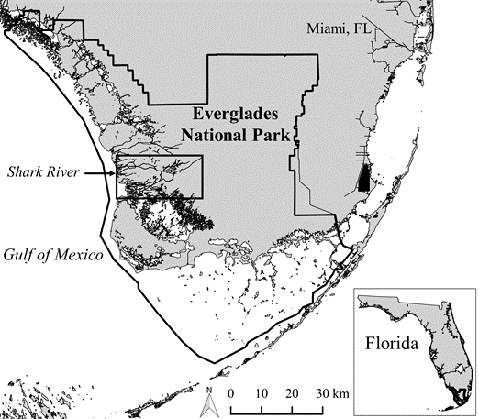

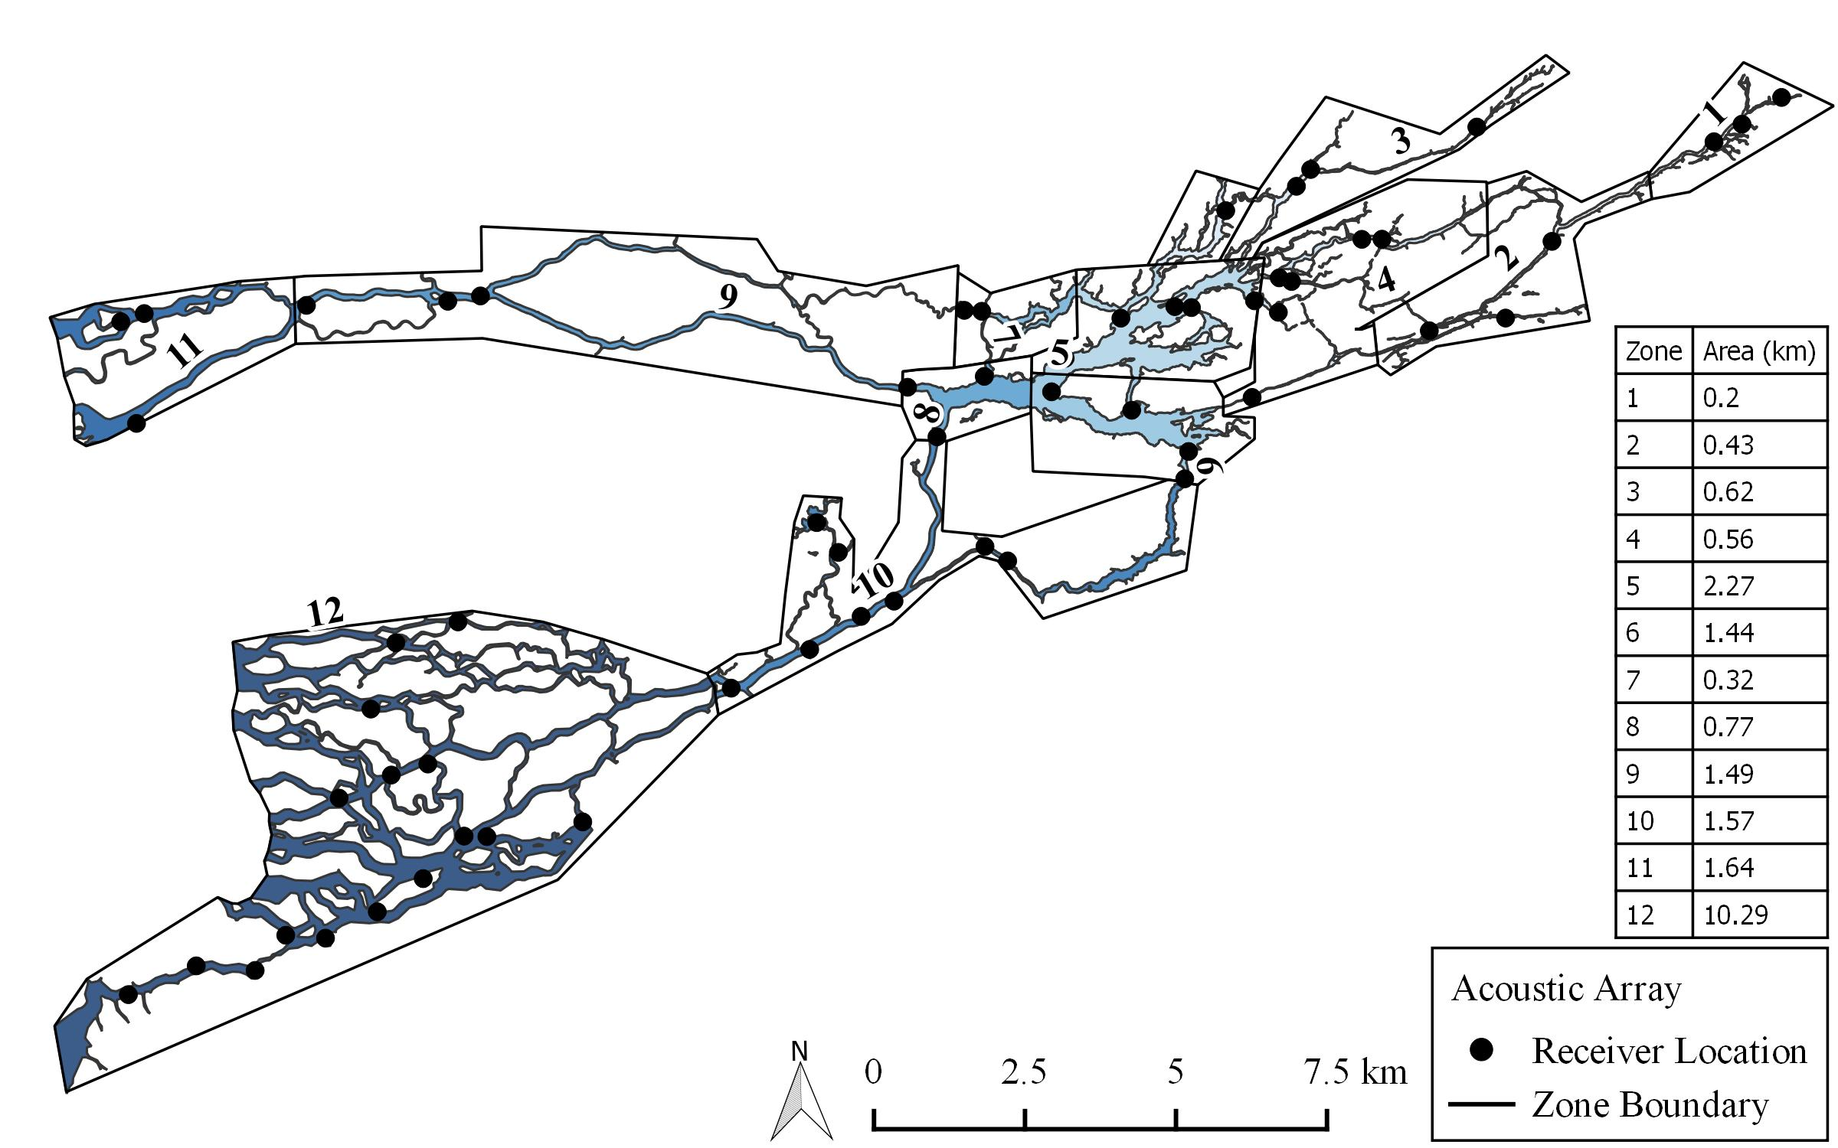
Methods
Fig 1. Study area: array of 38 receivers partitioned into 12 riverine zones
Florida Bay
Rookery Branch
Shark River Zones 1-12
Gulf of Mexico
Tarpon Bay

Slide 6
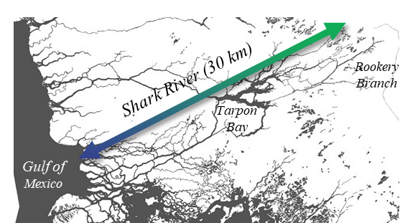
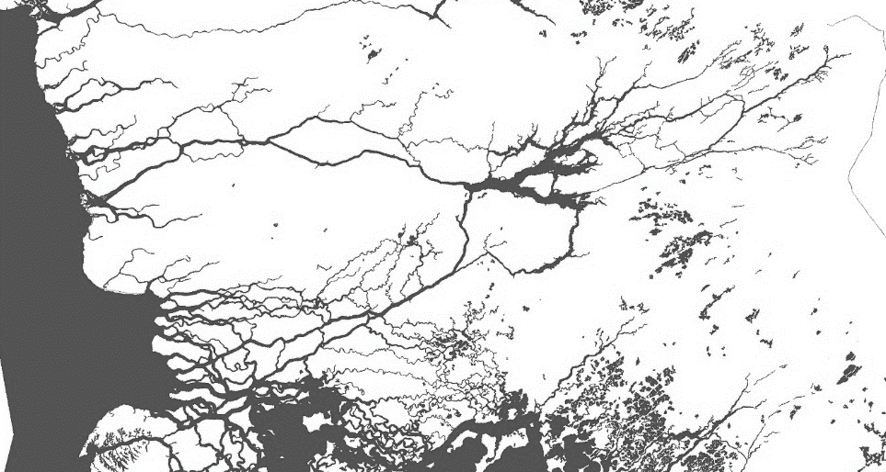
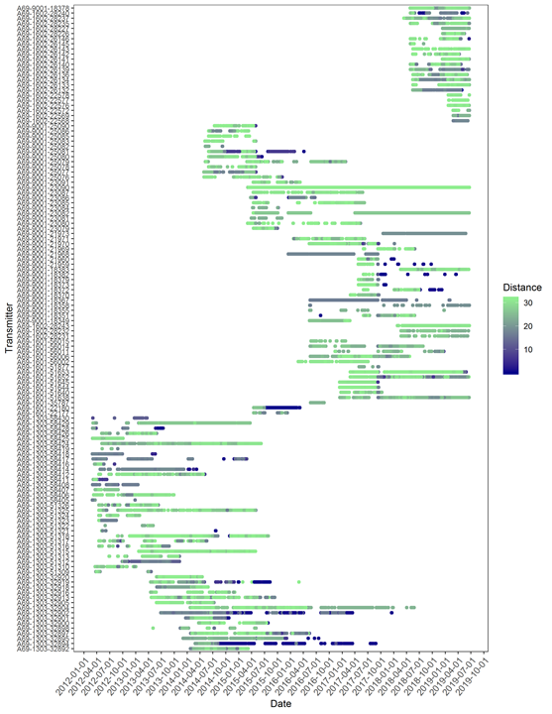
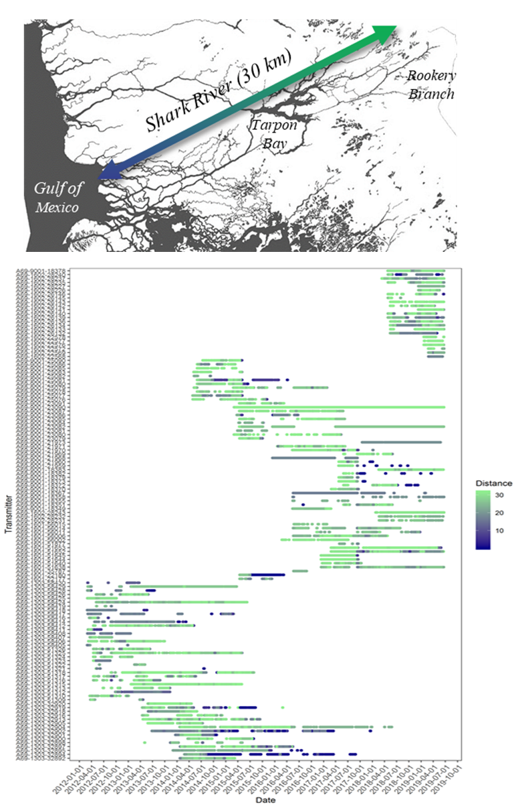
A
Shark River (30 km)
Rookery Branch
Tarpon Bay
Gulf of Mexico
Methods
Appendix 1. Detection histories for all snook used in the study
N = 120 fish
>90 days of detection
River km

Slide 7
Methods
E Index = Average pairwise resource dissimilarity between all individuals (i.e., Overlap in resource use; Zaccarelli 2013 Methods in Ecol & Evol )
0 = All individuals use the same resources in the same proportions
1 = Every individual relies entirely on different resources
Resources = receiver detections across 12 river zones (Matich et al 2017 L&O)
Calculated monthly E across all snook & compared monthly E’s across seasons/year related to flows with GAMs (beta distribution and logit link function)
PCA GAMs to relate E to river stage
-River stagee characterization: PCA based on the mean and variation (+ 1 month lag) of river stage across 4 locations
- gaussian distribution and a log link function
Calculate relative change in E across seasons for each zone/year
Cluster analysis

Slide 8
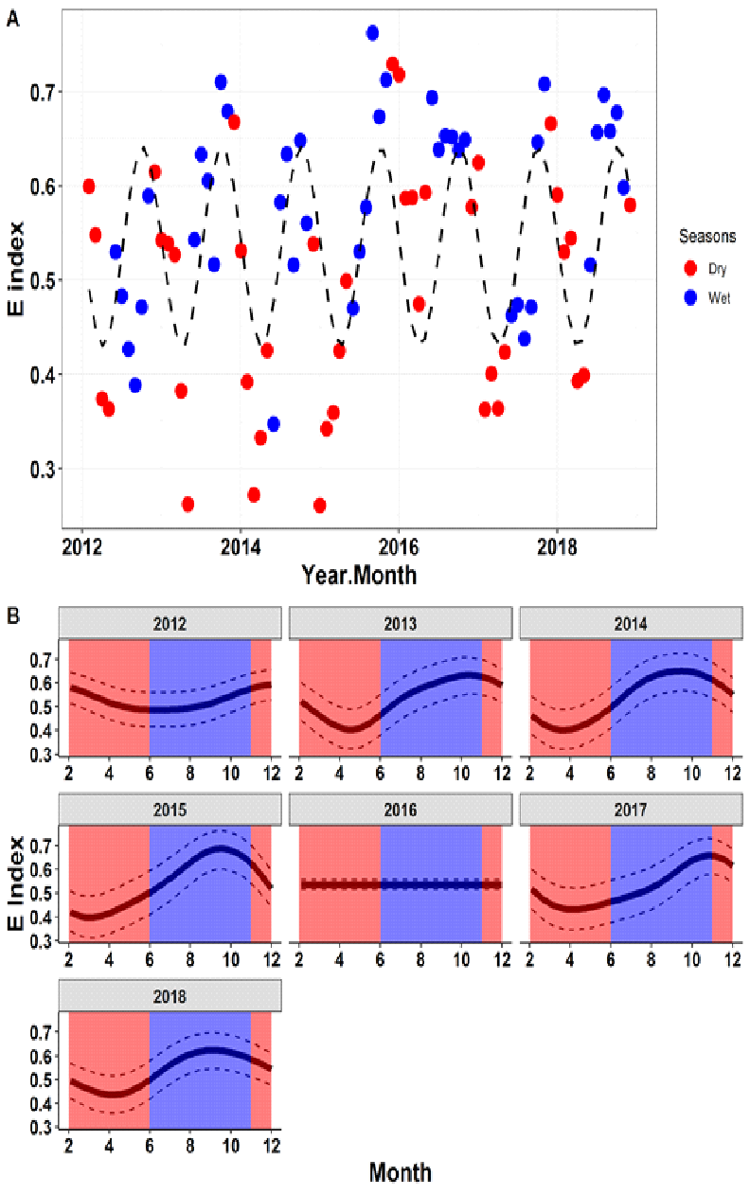


Fig 2
E index: 0-1
1 = individuals use different zones
0 = individuals use proportionally same zones
+ Individual variation
Notes:
Does the degree of similarity in space use vary over time (seasons, years)?

Slide 9
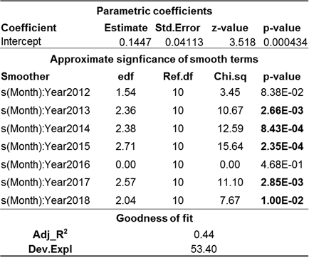

Results Fig 2
E box plot for wet vs dry
Analysis run based on new zones,
2012-2016 - dry season is not low for E
2014, 2015
Edf -approaches 1 =linear, 2 = parabolic
Higher value = more nonlinear
2018 borderline
2017- compressed, minimal shift
Blue dots are more bound than red
E index: 0-1
1 = individuals use different zones
0 = individuals use proportionally same zones
How does the level of intraspecific variation in space use vary over time (seasons, years)?
E cycles across wet & dry seasons. E Index is lower in the dry season – indicating similar space use & aggregation & higher in the wet season indicating differentials space use & dispersion
Across 7 years, E differs between wet and dry 5 of 7 years. The exceptions are 2012 & 2016 two years that follow a drought – prey pulse is small (Boucek et al. 2016)
Notes:
Does the degree of similarity in space use vary over time (seasons, years)?

Slide 10
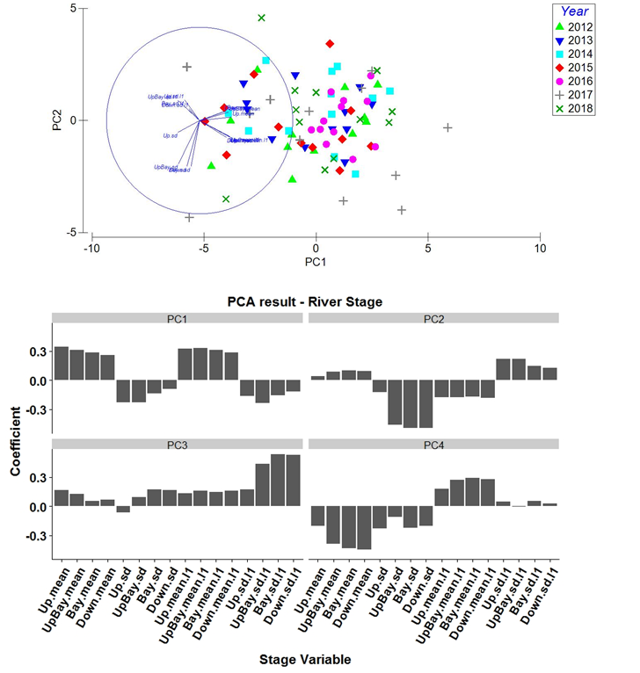
2. Is interspecific variation in space use related to hydrological conditions?
Characterized hydrological conditions across river with a PCA stage across 4 stations in the river & then conducted model selection to select PCs to describe hydrology
16 variables
4 monthly averages
4 Monthly SD
4 Average of previous month
4 SD of previous month
PC1 – mean stages
PC2 - sd of present stage
PC3 -sd of previous month downriver
Best model has PC1 & PC3
Appendix 2. PCA results

Slide 11
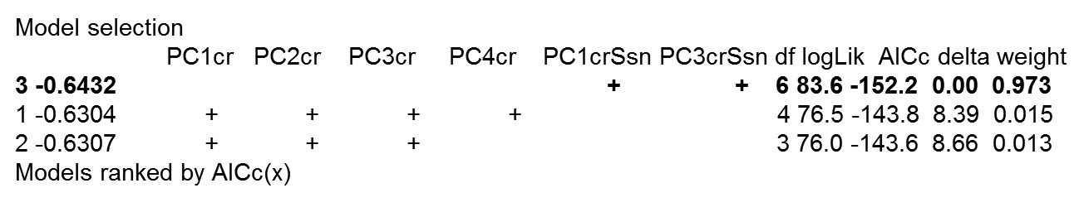
2. Is interspecific variation in space use related to hydrological conditions?
Characterized hydrological conditions across river with a PCA stage across 4 stations in the river & then conducted model selection to select PCs to describe hydrology
16 variables
4 monthly averages
4 Monthly SD
4 Average of previous month
4 SD of previous month
PC1 – mean stages
PC2 - sd of present stage
PC3 -sd of previous month downriver
Best model has PC1 & PC3
Appendix 2. PCA results

Slide 12



Results Appendix 3
Jan
Dec
2018-2019
2011 drought
2015 drought
2016 El Nino
Irma
2017 droughty?

Slide 13
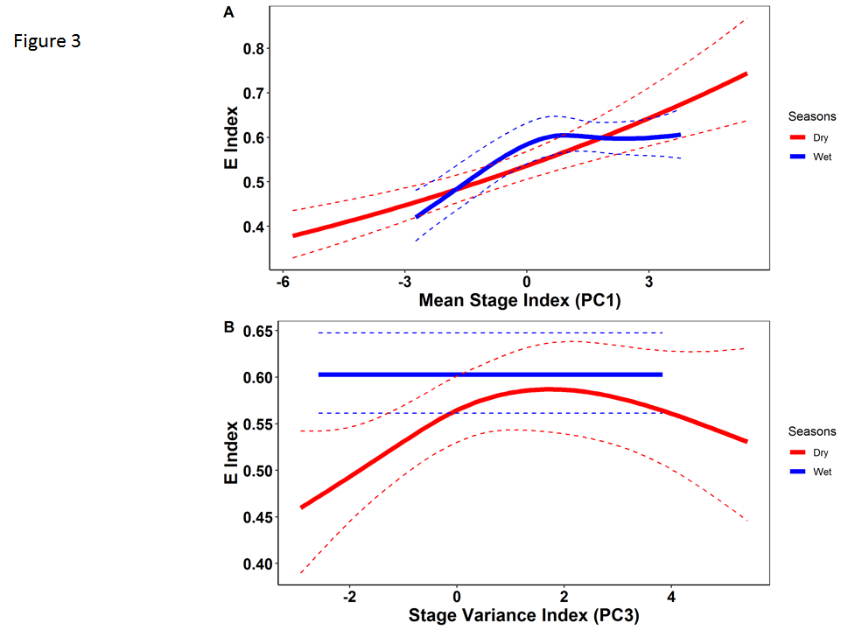
Results Fig 3
PC1-PC3dry almost linear
Nonlinear for PC1 wet
Stage matters
Particularly in dry season
Higher range of response
Low stage = similar space use
High sstage = dissimlar space e
Stepwise relationship -
Strongest relationship between to dry season PC1 stage
Most of variaiblity in E is explained by PC1
Secondarily by wet stage
Is interspecific variation in space use related to hydrological conditions?
Yes! Individual variation in space use is most strongly affected by dry season stage
Relationship is positive: as stage increases in dry season, space use becomes more variable = animals use different zones. At low stage, space use is most similar
In wet season, space use varies less. E is also positively related to stage, but levels off – at lower stages, ind variation goes up with stage, but as stage increases space use remains the same.
Variance in stage is less important & only affects dry season Es. Highest levels of ind variation (dispersion in space) at intermediate levels of variance (downriver)

Slide 14
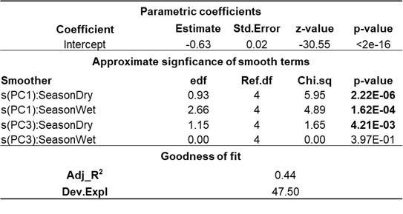
Results Fig 3
PC1-PC3dry almost linear
Nonlinear for PC1 wet
Stage matters
Particularly in dry season
Higher range of response
Low stage = similar space use
High sstage = dissimlar space e
Stepwise relationship -
Strongest relationship between to dry season PC1 stage
Most of variaiblity in E is explained by PC1
Secondarily by wet stage
Edf = 1 linear
Edf > 1 parabolic
Is interspecific variation in space use related to hydrological conditions?
Yes! Individual variation in space use is most strongly affected by dry season stage
Relationship is positive: as stage increases in dry season, space use becomes more variable = animals use different zones. At low stage, space use is most similar
In wet season, space use varies less. E is also positively related to stage, but levels off – at lower stages, ind variation goes up with stage, but as stage increases space use remains the same.
Variance in stage is less important & only affects dry season Es. Highest levels of ind variation (dispersion in space) at intermediate levels of variance (downriver)

Slide 15
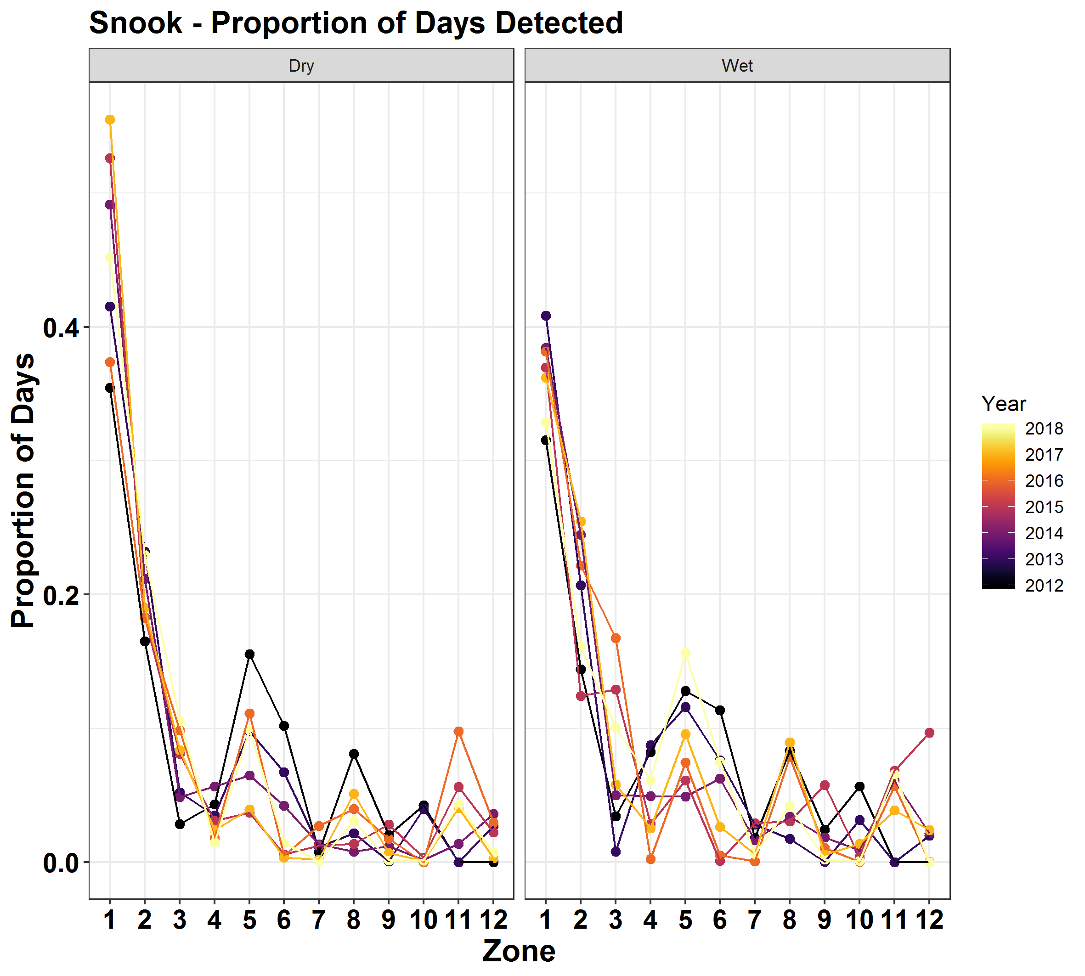
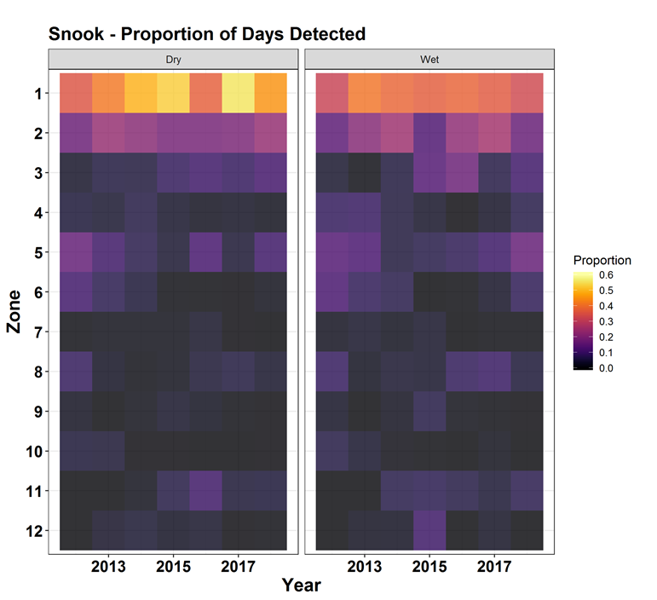
Results Appendix 3
Mean P across zones
Unique # of days per zone
Over total # of days of detection record
Average across individuals and month for dry season
fish*zone*season matrix
For each month, y is zones as columns and calculated per ind (rows), how many days detected in in zone- totalled row to get a proportion, and used and then averaged across year/zone/season
This gives monthly proportion per individual, averaged across zone
zones
3. What is the distributional pattern that results as a function of intraspecific variation?
Proportion of days detected in each zone & compared wet vs dry
Most space use is upstream in zones 1-2, but it changes between wet and dry
For each season*month
P = unique # of days per zone/ total # days in detection record for each fish
Averaged across all individuals
Monthly P- averaged across all months in that season

Slide 16
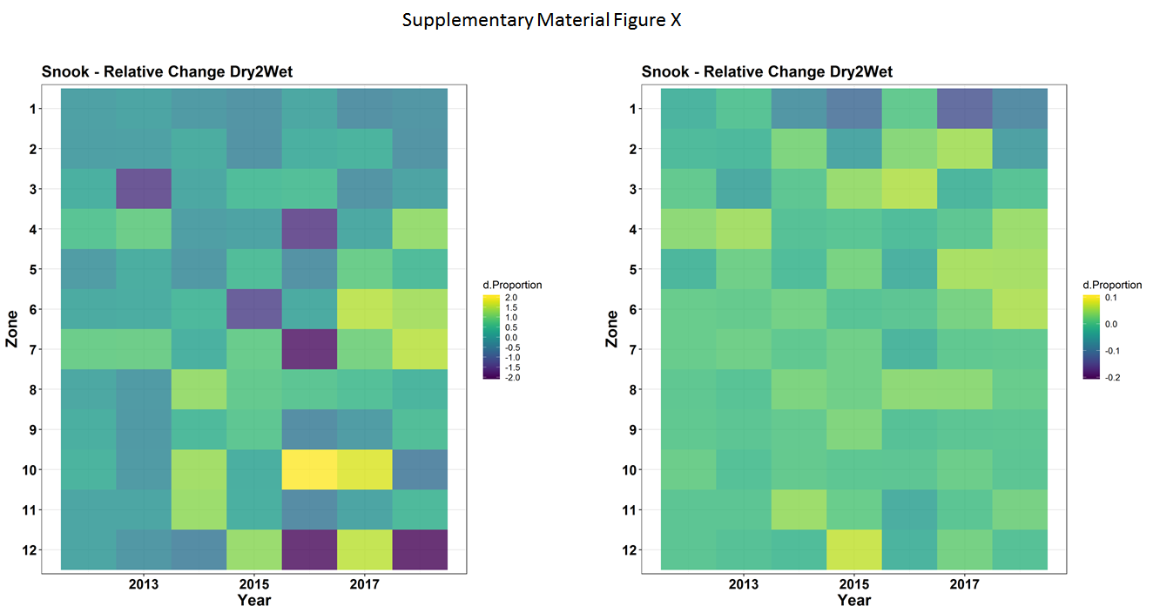
Results Fig 4
Relative change
Relative change from wet to dry
+ in wet
+ in dry
3. What is the distributional pattern that results as a function of intraspecific variation?
Relative change (symmetrical) from wet-dry season for each zone
Relative change: Wet-Dry /average (wet,dry) + = increase in wet season
- = increase in dry season
Across yrs: high variation 🡪 early yrs: less variable space use in any zone?
late yrs: more variable +/- TB, + Gulf,
Upper zones = low proportion change – always used (slightly negative)
Lower zones = higher proportional change

Slide 17
Results Fig 4
Relative change
Relative change from wet to dry
+ in wet
+ in dry
+ in dry
+ in wet
3. What is the distributional pattern that results as a function of intraspecific variation?
Relative change (symmetrical) from wet-dry season for each zone
Relative change: Wet-Dry /average (wet,dry) + = increase in wet season
- = increase in dry season
Across yrs: high variation 🡪 early yrs: less variable space use in any zone?
late yrs: more variable +/- TB, + Gulf,
Upper zones = low proportion change – always used (slightly negative)
Lower zones = higher proportional change
+ in wet
+ in dry
+ in dry

Slide 18
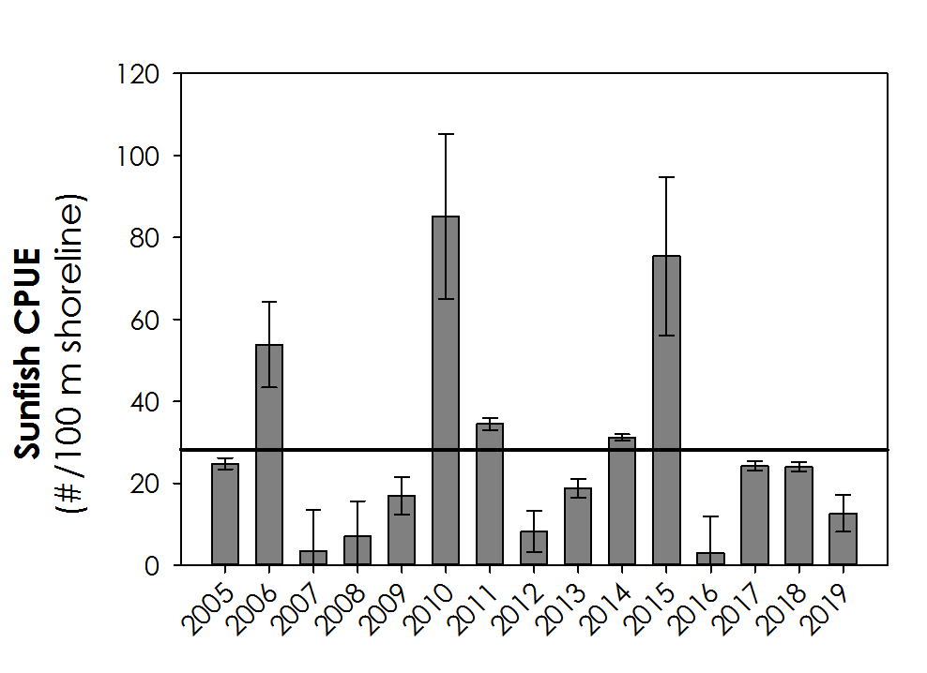
Relative change
Relative change from wet to dry
Peak monthly sunfish abundance
Average
+ in dry
+ in wet
Low Med High High Low Med Med
2011 drought
2015 drought
2016 El Nino
Irma
2017 droughty?
+ in wet
+ in dry
+ in dry
Low Med High Vhigh Low Med Med

Slide 19
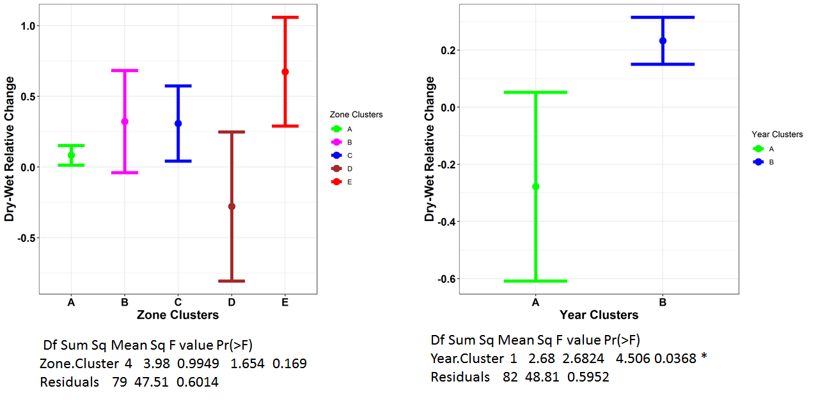
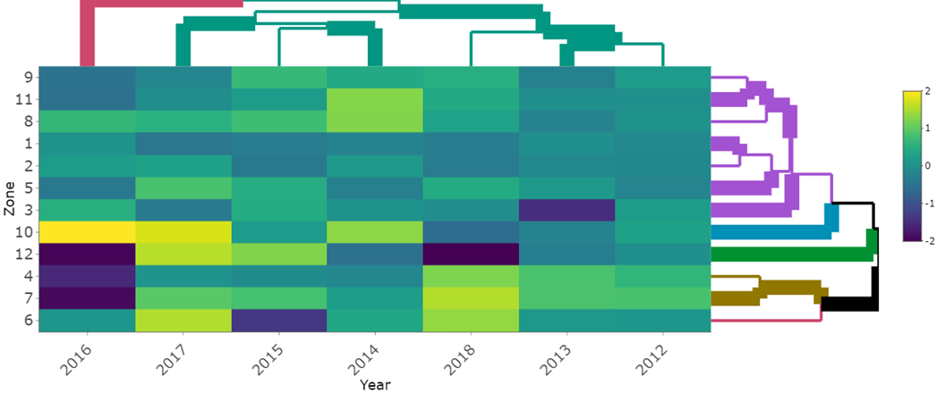
Results Fig 5
+ in wet
+ in wet
+ in dry
+ in dry
3. What is the distributional pattern that results as a function of variable intraspecific variation over space/time?
Cluster analysis to see commonalities among zones/years
Years: 2 clusters
Cluster A: 2016 (high change, El nino)
Cluster B: all other years
Zones: 5 clusters
Cluster A: least variable, 1,2, 3, 5, 8, 9, 11,
Cluster B: 6, trend for increase in wet
Cluster C: 4, 7 increase in wet
Cluster D: 12 higher use in dry
Cluster E: 10 highest use in wet

Slide 20
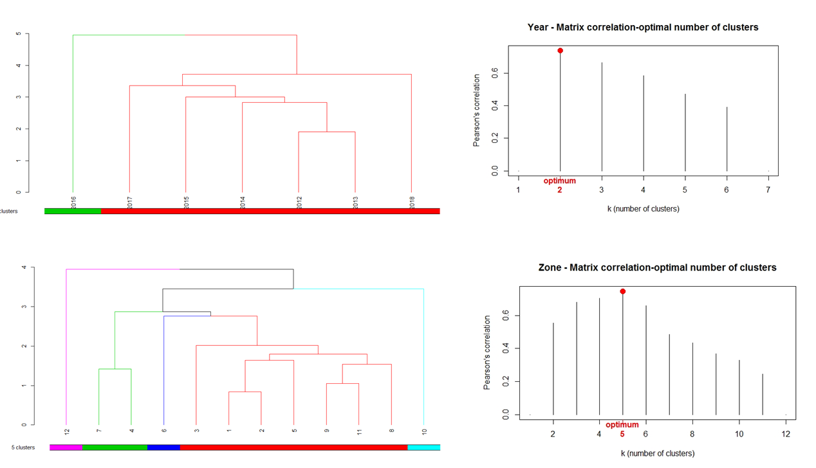

Slide 21
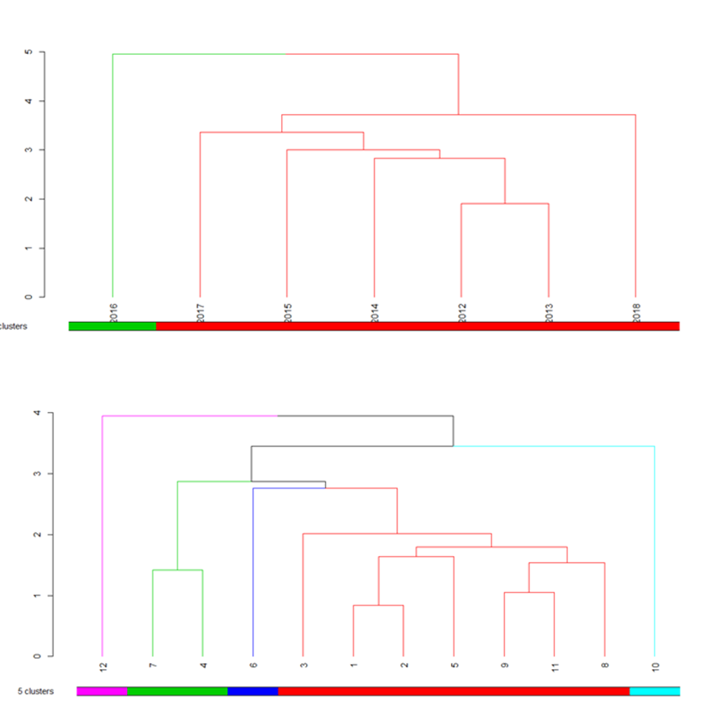
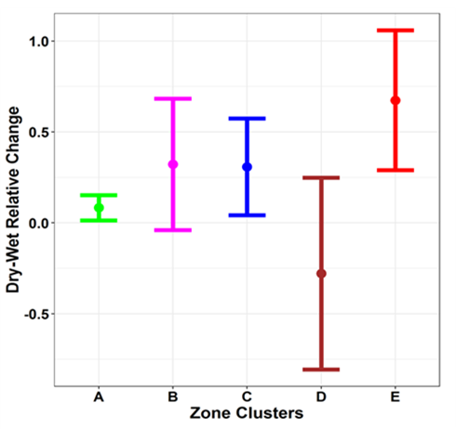

Slide 23
Key findings Discussion
How does the level of intraspecific variation in space use vary over time (seasons, years)?
Is this interspecific variation in space use related to hydrological conditions?
3. What is the distributional pattern that results as a function of variable intraspecific variation over space/time?
Levels of intraspecific variation in space use vary seasonally & are strongly affected by dry season stage:
high variation in space use at high stage & low at low stage
Observed this pattern most years, except 2012/2016
High year to year variation in space use, increased in more recent years?
2016 El Nino year has unique pattern of space use – highly variable increased used of bay & downstream
For other yrs, yr to yr variation does not match up to ranking of prey pulse – lots of reshuffling in space?
Intraspecific variation x env interaction =
Levels of variation among individuals are modulated by env conditions
Foraging = strong, consistent attractor
Shown previously
Years with no variation in E are lowest prey pulse years (post drought)
Higher mobility of snook in absence of predictable prey pulse?
Space use is highly variable in space across zones?

Slide 24
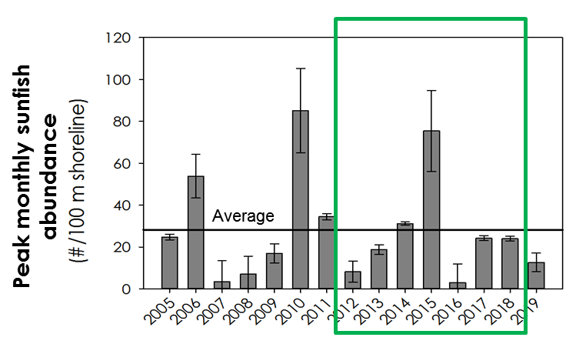
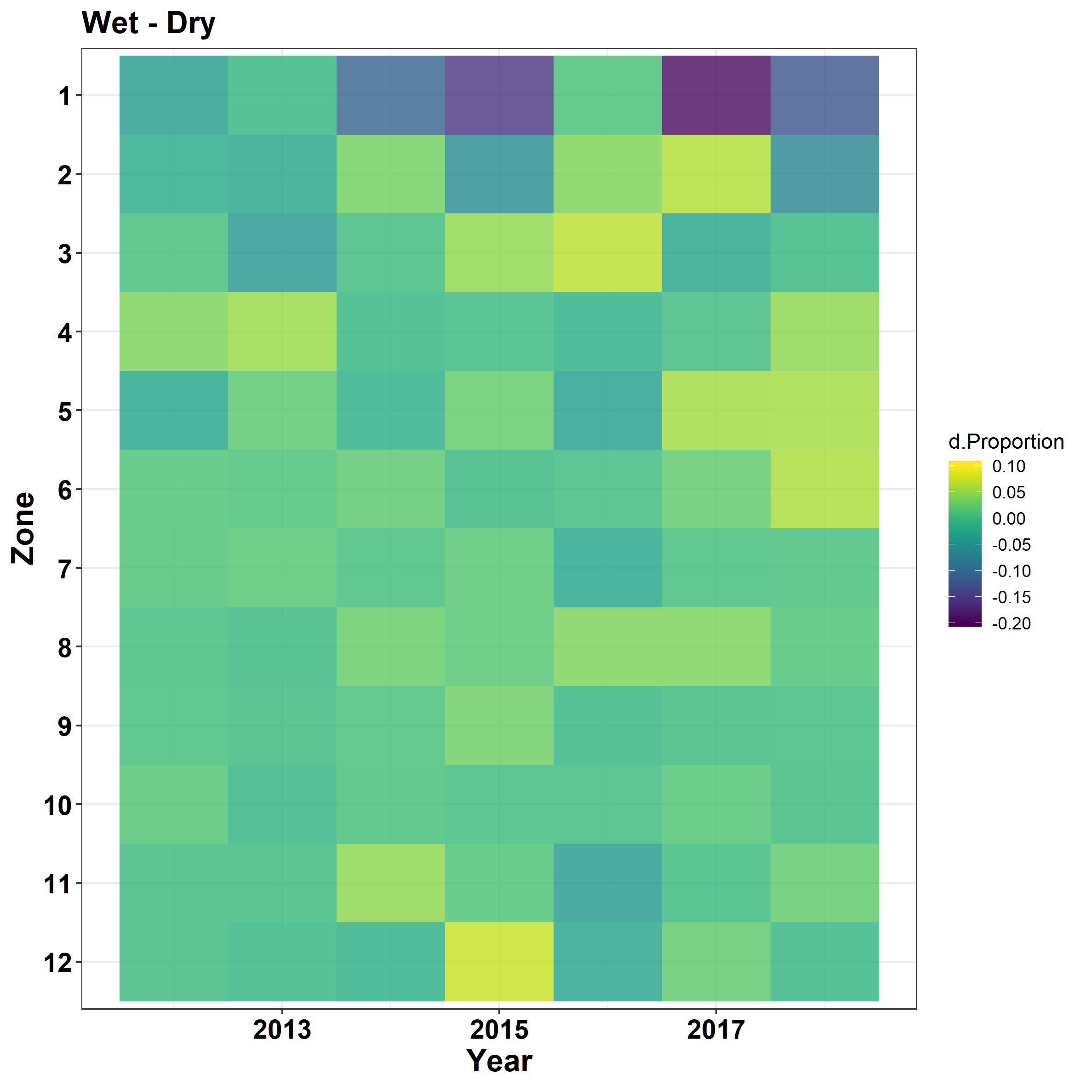
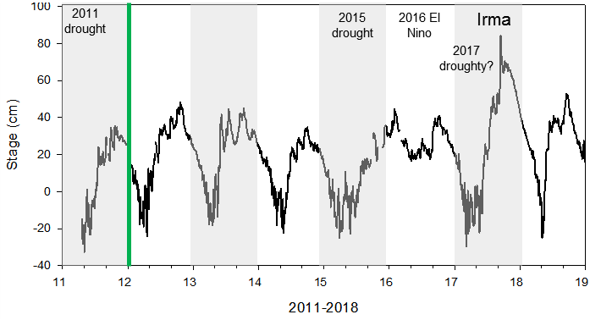
Change wet – dry
= higher use in dry
+ = higher use in wet
Negative = dry season is higher
Positive value = wet season is higher
Lower relative change
Low Med High Vhigh Low Med Med

Slide 25
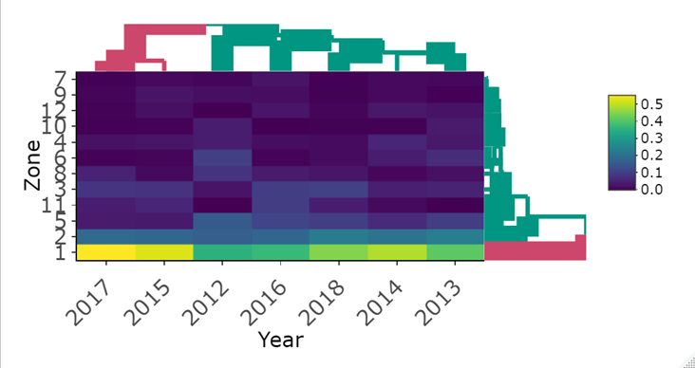
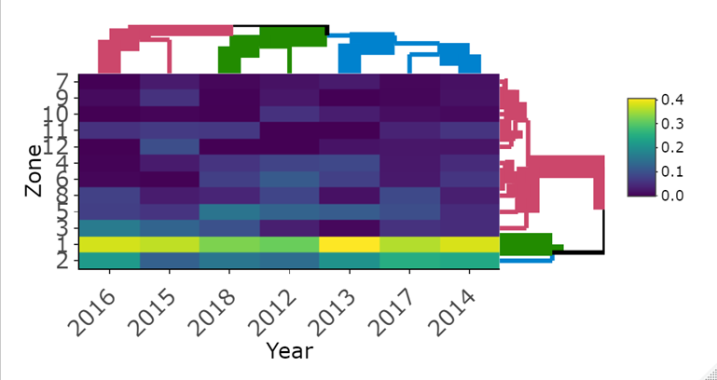
wet season
dry:
cluster 1: 2017/2015 cluster together -highest use of zone 1
cluster 2: all other yrs
wet:
3 clusters
2016/2015
2018/2012
2013/20
17/2014
dry season

Slide 26
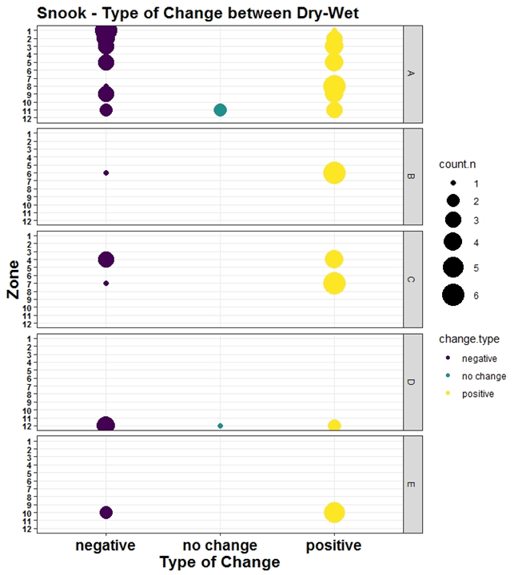

Slide 27
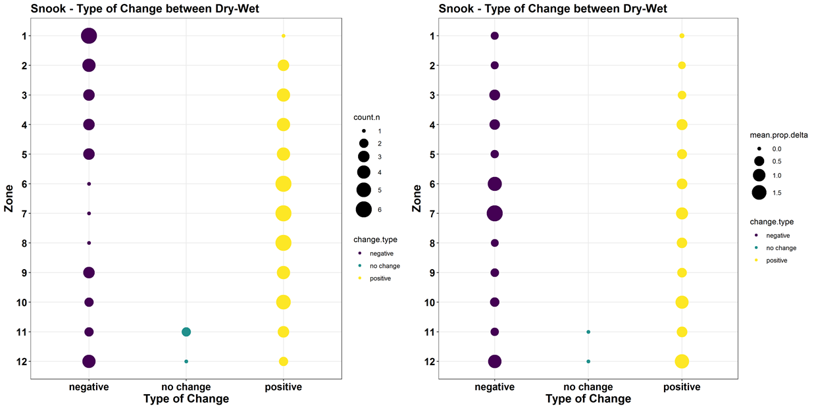
Mean of relative change over average-absolutely value
Count of years of

Slide 28
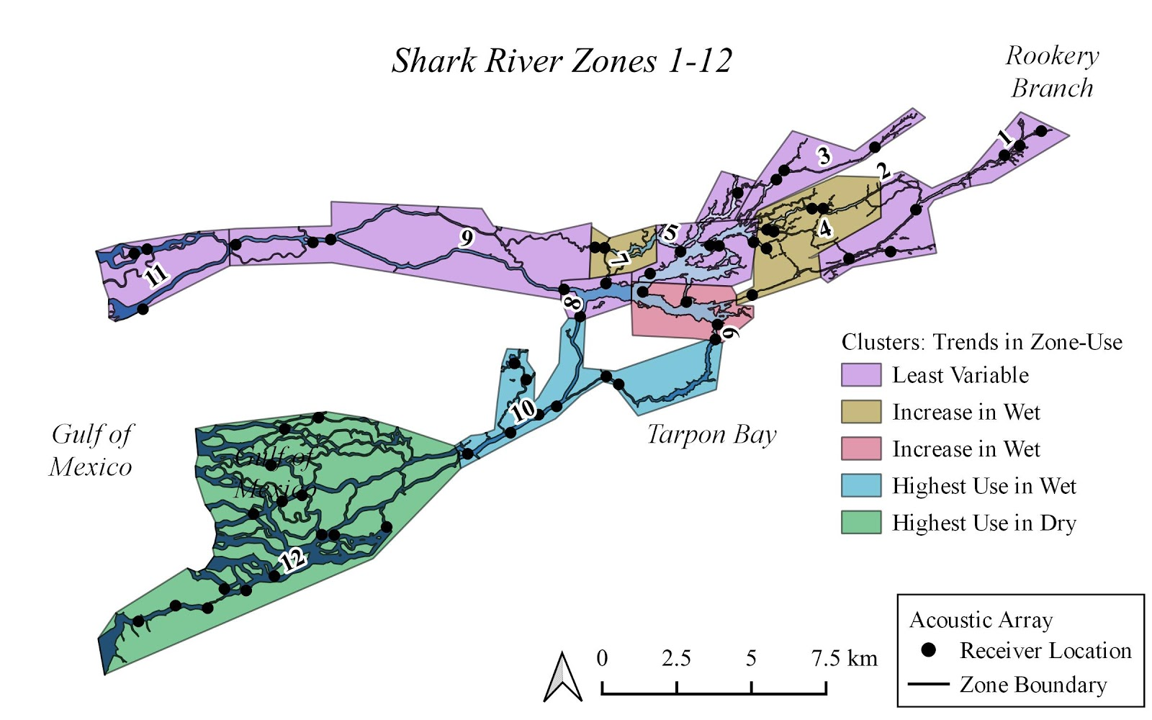

Slide 30
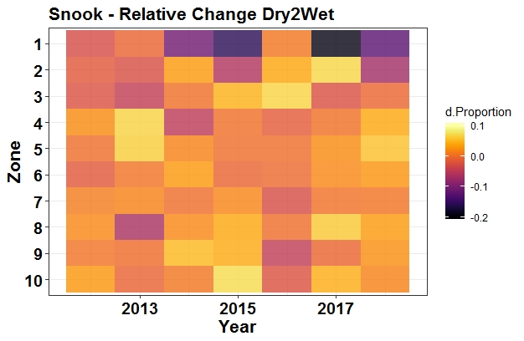
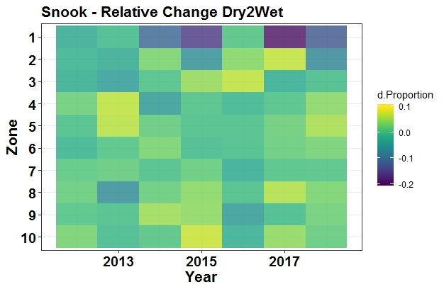
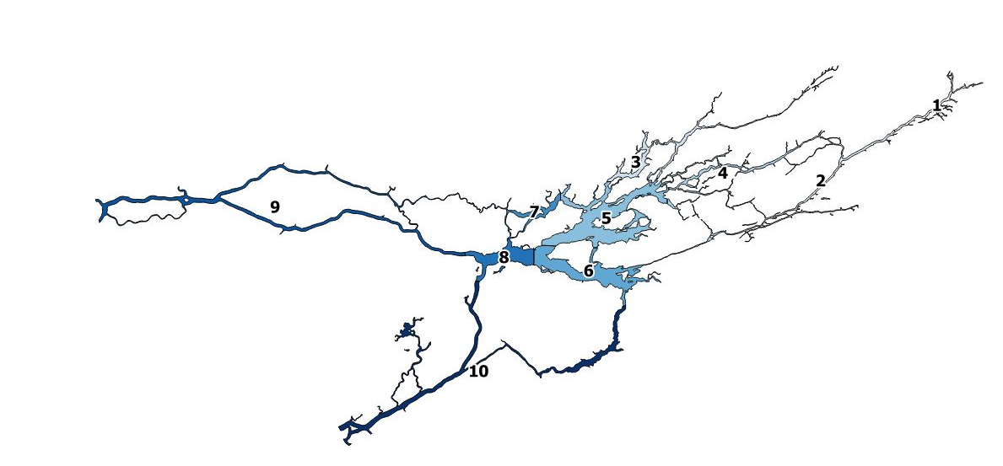
2012/2016 = post-drought, flat Es across years
Gains in wet season depend on year

Slide 31
What is prob of animal leaving zone
Apr-apr - everyone eats same thing
High e - wider niche
How does P of diet change to another source

Slide 32
we can do the actual change which is just: x - y or y - x and you calculated this on the phone last week & it looks pretty good, so we can proceed to do the cluster analysis with these actual change values
we can calculate relative change, but do it with a better indicator (at least one that is symmetrical-where the relative change is the same whether relative to x or y). For this, we can use (x-y)/mean (x,y) (this is the actual change divided by the mean) or log e (y/x) (this is the log based e of y divided by x). I would suggest that we try both of these & see how the heat maps looks with these 2 measures of relative change & then we can try the cluster analysis on the better one?
then we can compare 1 and 2-both the heat map of the actual vs relative change and the cluster analysis for both & see if we are there, how does this sound?

Slide 33
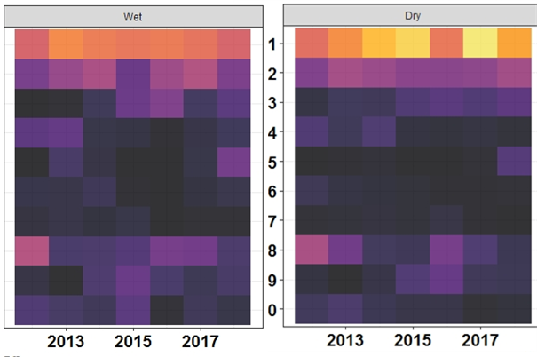
Wet is x and dry is y
So for each zone and year, we take the difference for the nominator (wet for zone 1/ year 1 – dry for zone 1/year 1)
And for the denominator we do sum of (wet zone1year1, dry zone1year1) & then divide by 2 to get mean
We repeat for all year and zone combinations
And then we make the heat map of this new relative change metric

Slide 34
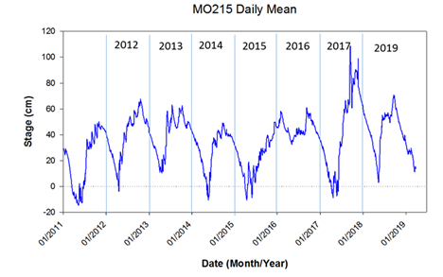
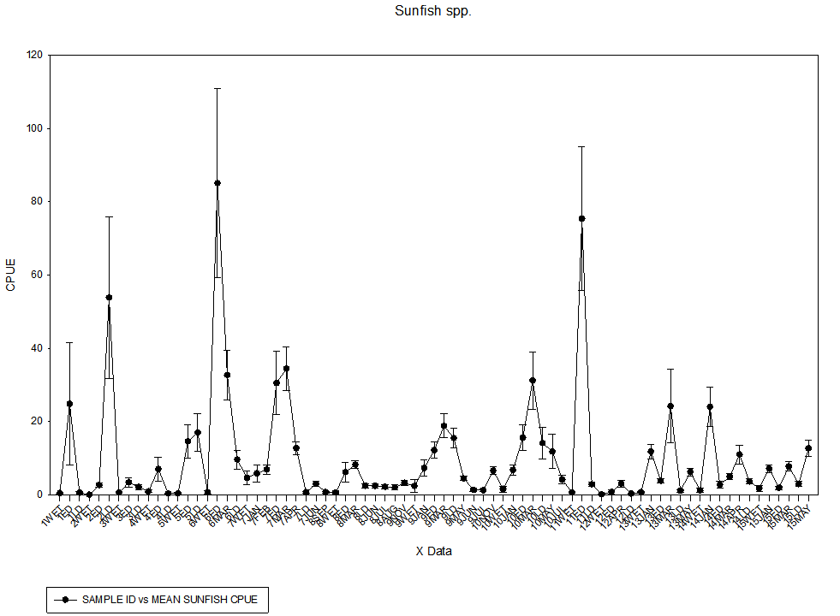
Post drought = mortality
Wet = absence of migration into estuary

Slide 36

Appendix Fig A. Some version of this figure to show hydrology perhaps with table with metrics, # of days dry or similar on side of figure

Slide 37
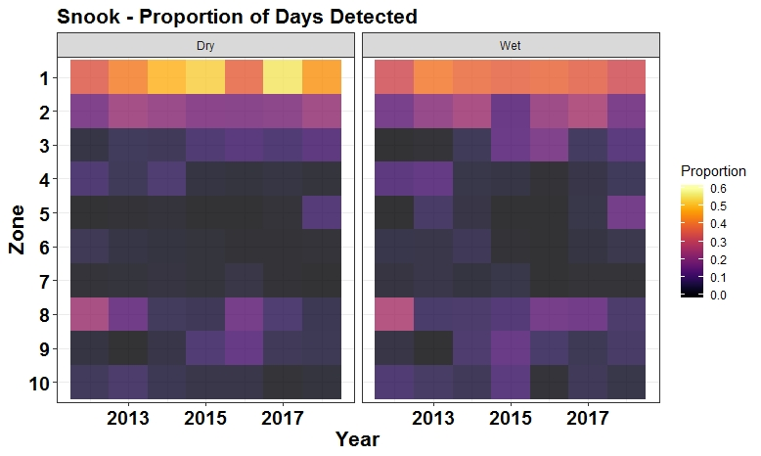
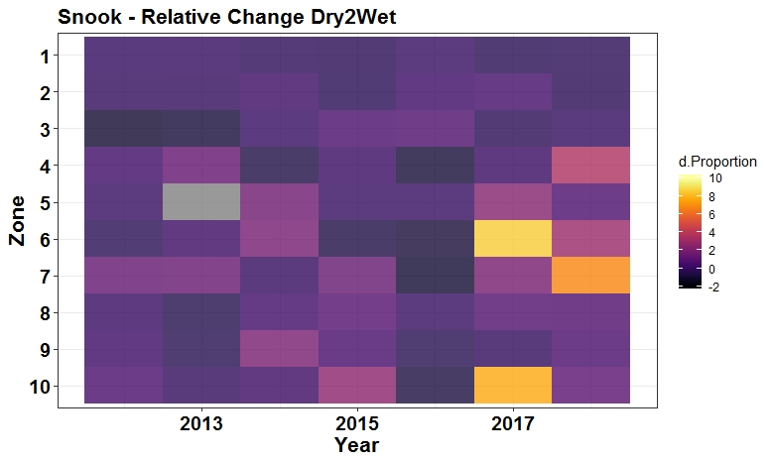
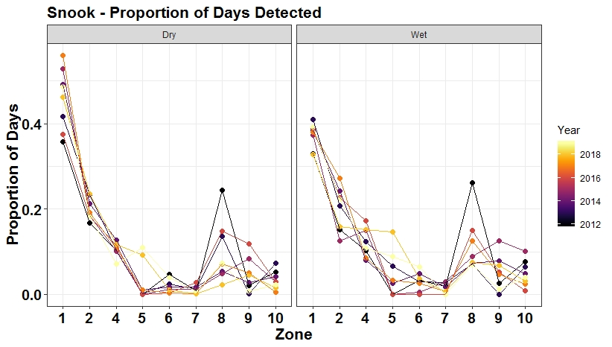
3) Where is spatial aggregation happening?
Answer: ?
Approach:
Extract detection days for fish*zone*year combination & then for each fish calculate prop of detection days in each zone
Fishi, Yeari: P1, P2…… P10 & then average across all fish to get a mean P for each zone
This shows that across the 10 zones, most detections are in headwaters in the wet season –about 35% in Z1 & 20% in Z2. In dry season, P1i ncreases from ~ 35% to 48%, P2/P4/P5 becomes less variable across yrs , but not the same effect downstream
Problem: we don’t’ see evidence of change in zones – the increase at headwaters & decrease elsewhere – need to come up with better figure for this
Absolute change = value 2 – value 1
Relative change = value 2 – value 1/ value 1 * 100%
*
*
*
*
wet-dry/dry

Slide 38
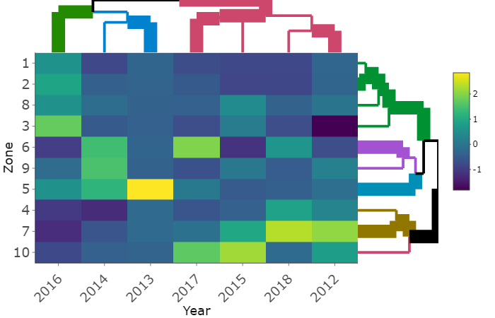
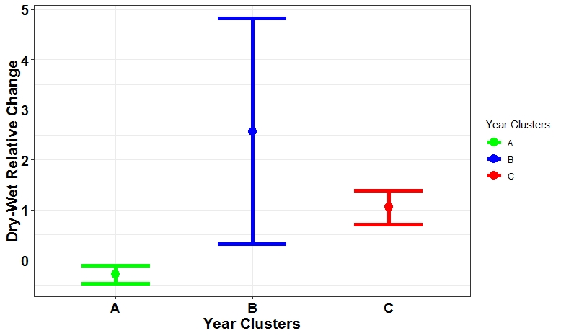
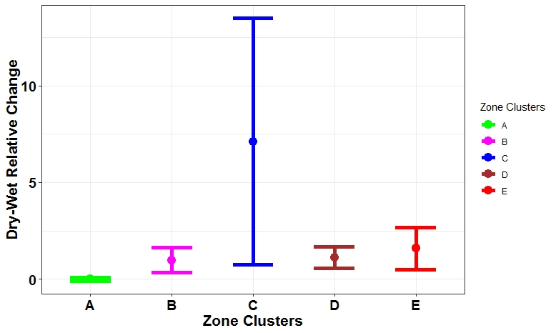
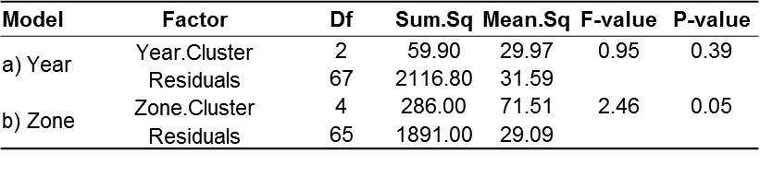
A
B
C
A
B
C
D
E
Dry - wet/ dry =
poistive values decrease in dry
Negative values increase in dry
3) Where is spatial aggregation happening? Post drought years with no variation are 2012/2016
Answer: ?
Approach: Relative space use = wet – dry / dry – we should see decreases at headwaters & increases downstream
Cluster A: 2016 – no change
Cluster B: 2013-2014 –variable change
Cluster C: 2017, 2015,2018 & 2012 – higher change
Zones: 1, 2, 8, 3
Zones: 6,9
Zone: 5
Zone: 4-7
Zone 10

Slide 39


Slide 40
Model selection
PC1cr PC2cr PC3cr PC4cr PC1crSsn PC3crSsn df logLik AICc delta weight
3 -0.6432 + + 6 83.6 -152.2 0.00 0.973
1 -0.6304 + + + + 4 76.5 -143.8 8.39 0.015
2 -0.6307 + + + 3 76.0 -143.6 8.66 0.013
Models ranked by AICc(x)
PC | Eigenvalues | %Variation | Cum.%Variation
1 | 5.9 | 36.9 | 36.9
2 | 2.8 | 17.5 | 54.3
3 | 2.67 | 16.7 | 71
4 | 2.38 | 14.9 | 85.9
5 | 1.05 | 6.6 | 92.5

Slide 41
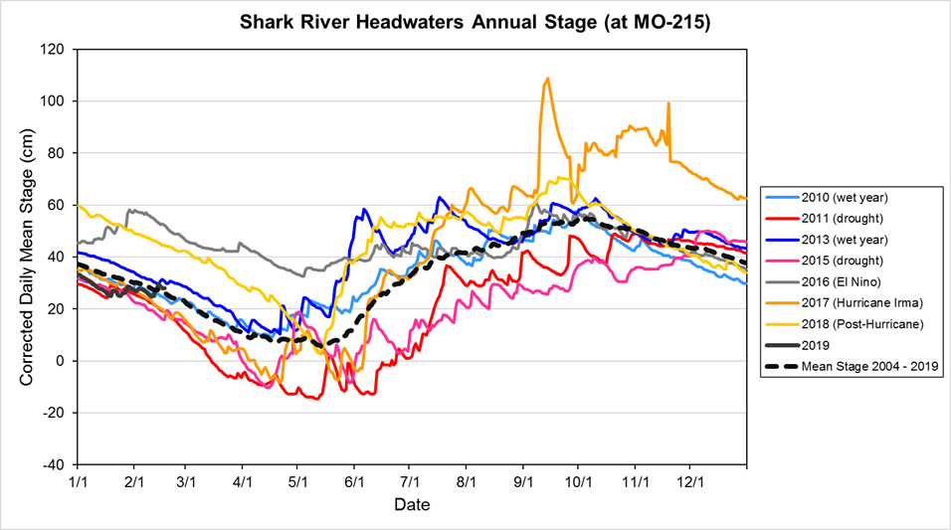

Slide 42
Introduction: rationale
1) A primary way in which animals responds to env heterogeneity is with their movements
2) A lot of this variation in the env is spatial i.e., high v low quality resource patches
3) But recent work emphasizes temporal variation, and the fact that they interact
4) For instance org track phenological variation in resources across space (ie resources waves
5) Yet most studies examining this have been terrestrial
6) In our study, we…

Slide 43
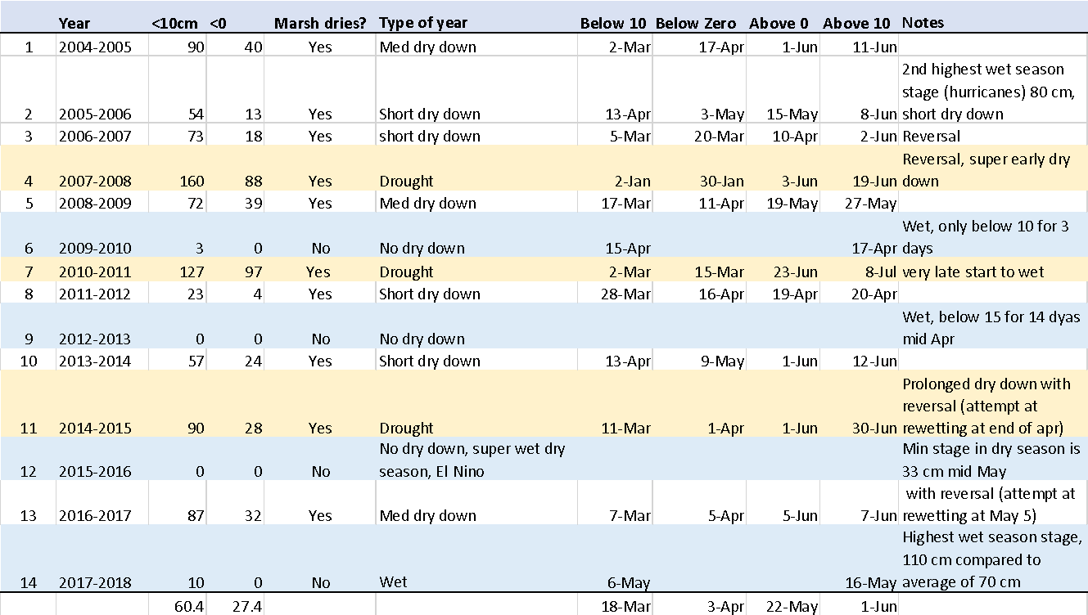

Slide 44
2011 drought
2015 drought
Irma
At headwaters

Slide 45
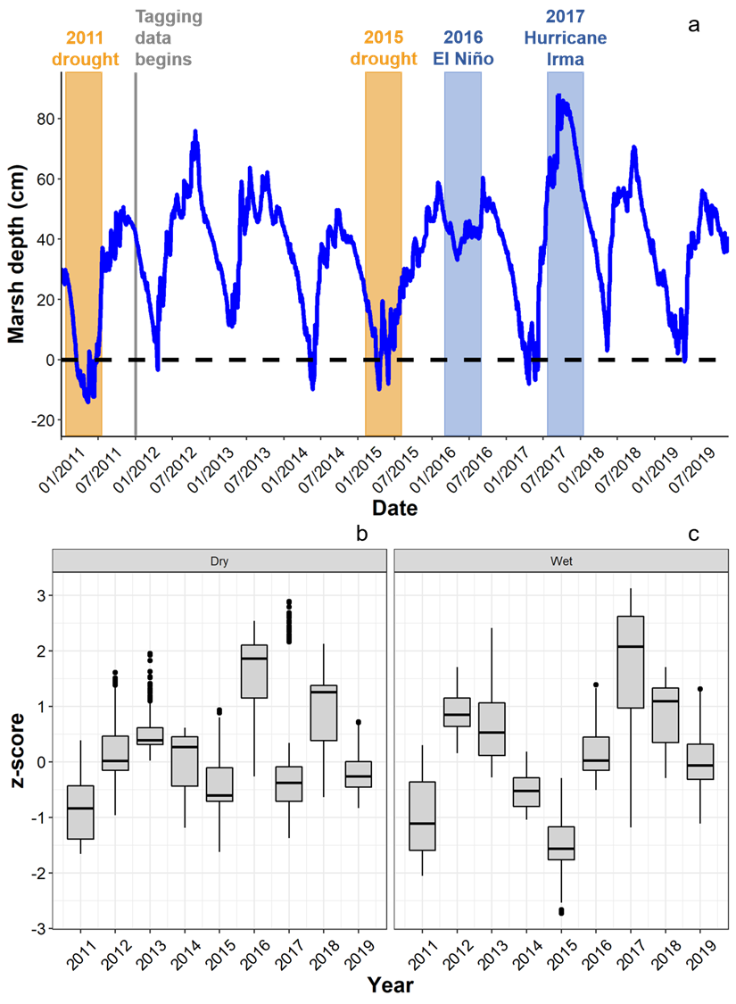
Appendix 2

Slide 46
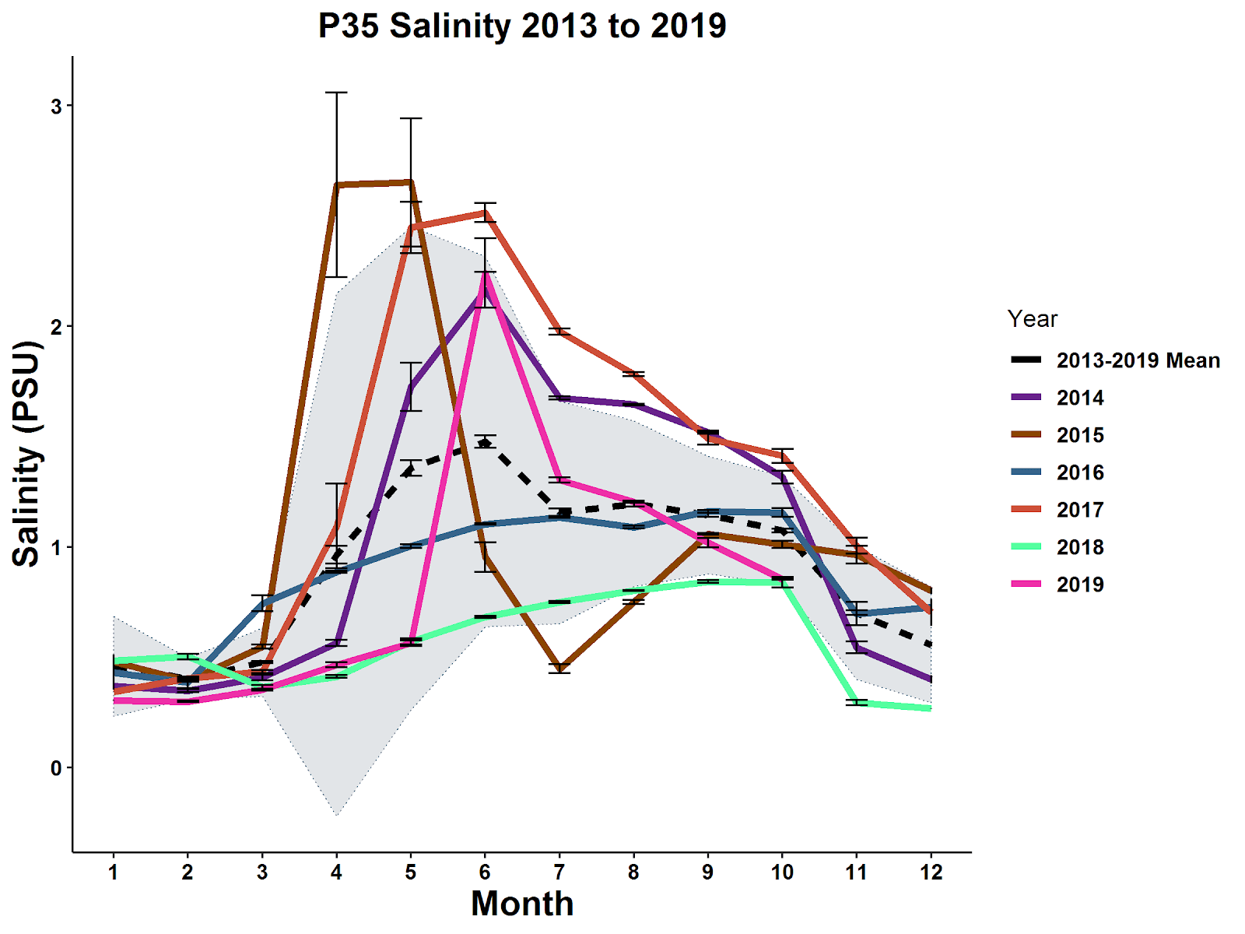


Slide 47


Slide 48


Slide 49


Slide 50




Slide 51


Slide 52


Slide 53


Slide 54


Slide 55



Slide 56



Slide 57

Scott Colborne Sturgeon sequence analysis Scolbor@gmail.com

Slide 58


Slide 59


Slide 60


Slide 61


Slide 62


